Slide 1
CMSC 28100 Introduction to Complexity Theory Autumn 2025 Instructor: William Hoza
⏳

Slide 2
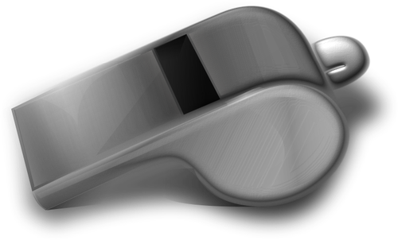
TMs can simulate all “reasonable” machines
We could add various bells and whistles to the basic TM model
Left-right-stationary Turing machines
Multi-tape Turing machines
A Turing machine with a two-dimensional tape
None of these changes has any effect on the power of the model
🔔

Slide 3
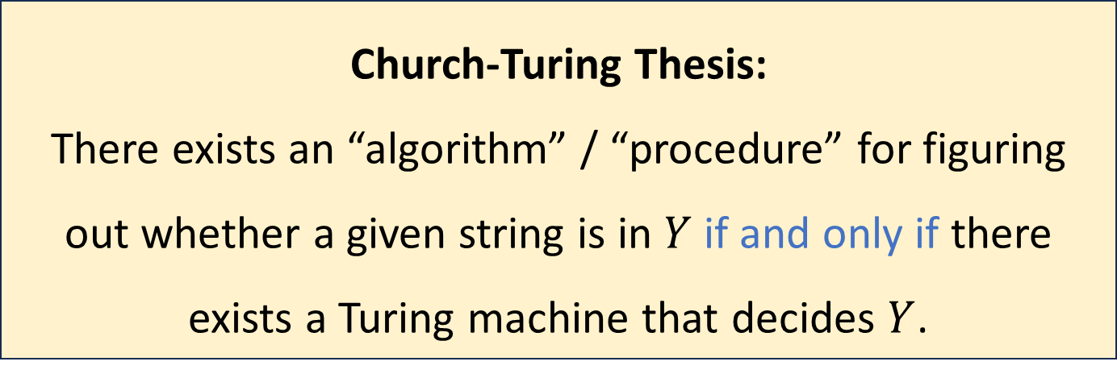
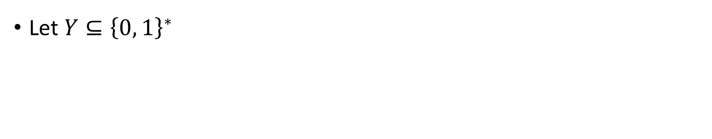
The Church-Turing Thesis
Let $Y⊆{\left\{0, 1\right\}}^{∗}$
Church-Turing Thesis:
There exists an “algorithm” / “procedure” for figuring out whether a given string is in $Y$ if and only if there exists a Turing machine that decides $Y$.
Intuitive notion
Mathematically precise notion

Slide 4





Turing machines vs. your laptop
OBJECTION:
“Each individual Turing machine can only solve one problem.
My laptop is a single device that can run arbitrary computations.
Therefore, Turing machines don’t properly model my laptop.”
Email machine??
General purpose computer
Zoom machine??
Tetris machine??
Photoshop machine??

Slide 5
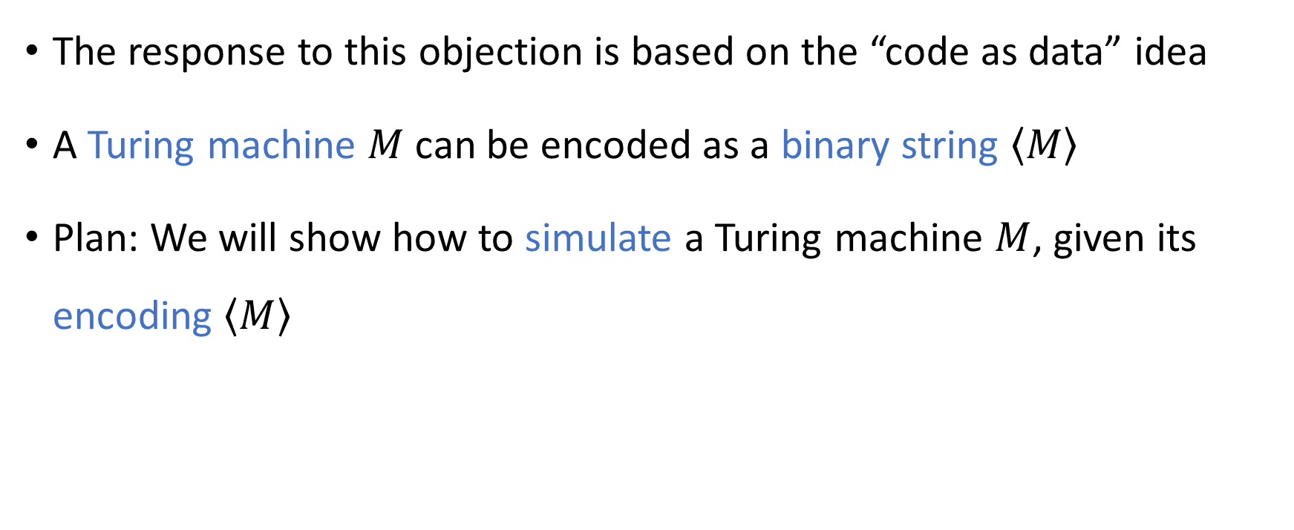
Code as data
The response to this objection is based on the “code as data” idea
A Turing machine $M$ can be encoded as a binary string $\left\langle M\right\rangle$
Plan: We will show how to simulate a Turing machine $M$, given its encoding $\left\langle M\right\rangle$

Slide 6
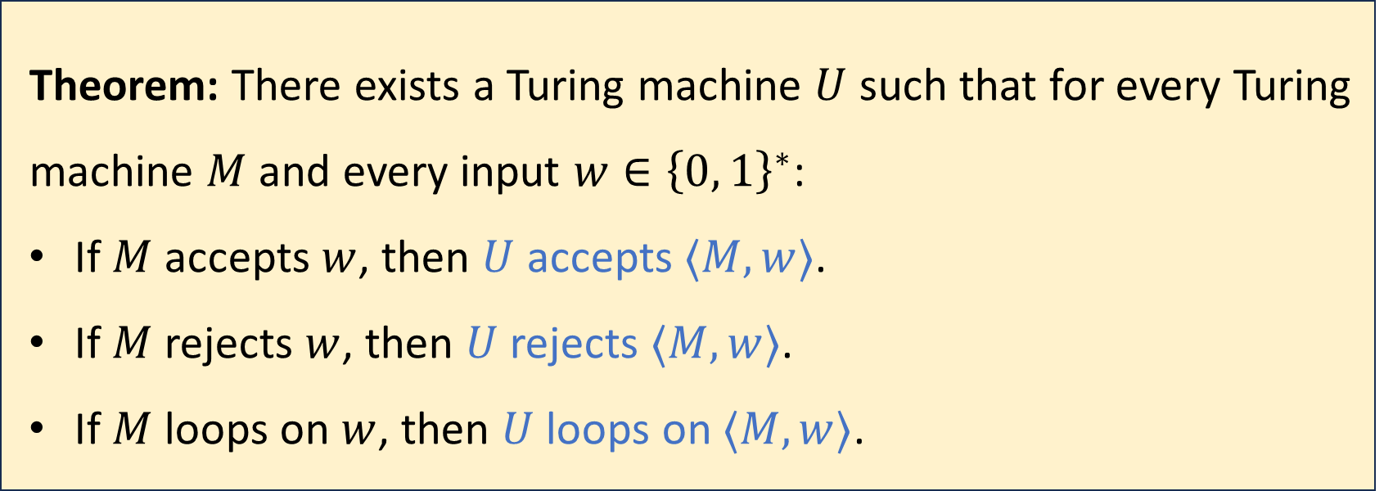
Universal Turing machines
Theorem: There exists a Turing machine $U$ such that for every Turing machine $M$ and every input $w∈{\left\{0, 1\right\}}^{∗}$:
If $M$ accepts $w$, then $U$ accepts $⟨M,w⟩$.
If $M$ rejects $w$, then $U$ rejects $⟨M,w⟩$.
If $M$ loops on $w$, then $U$ loops on $⟨M,w⟩$.
One super-algorithm that contains all other algorithms inside it!

Slide 7
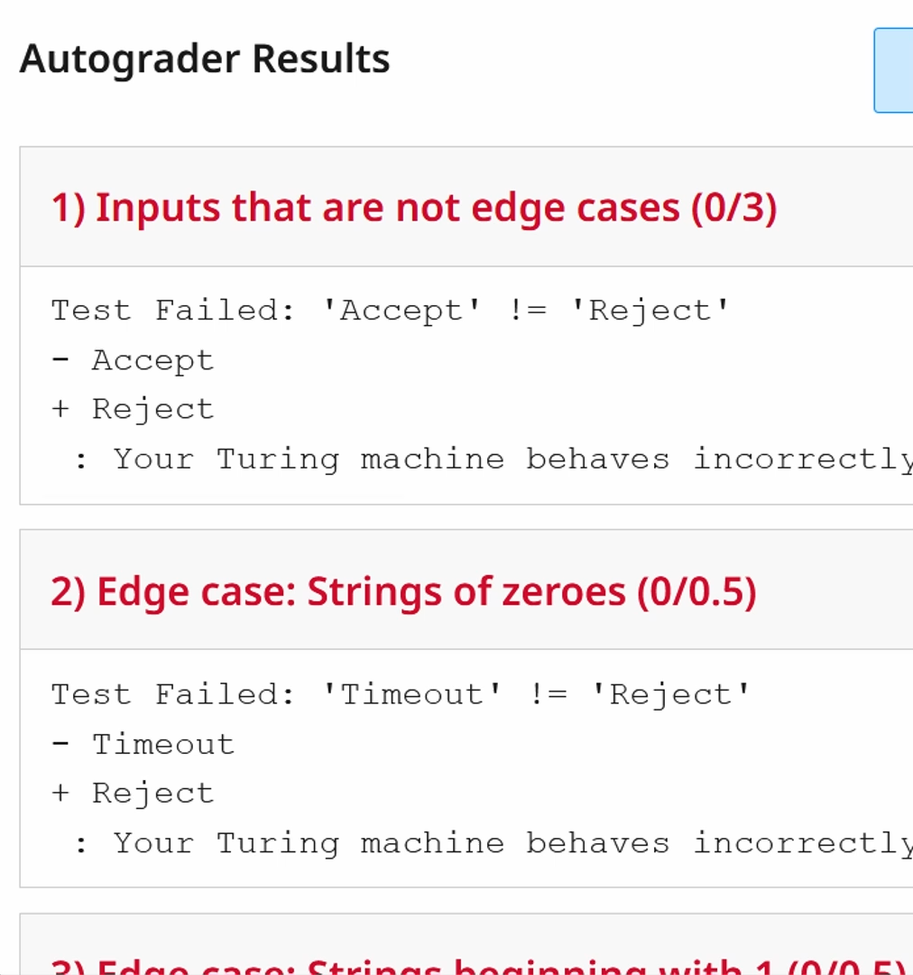
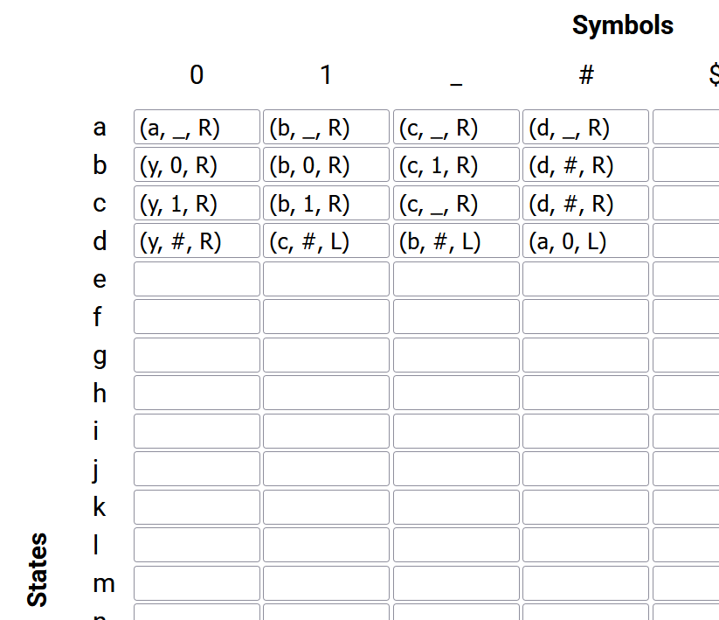



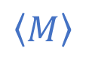

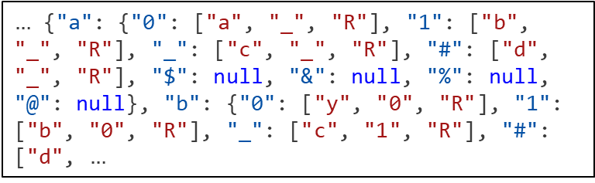
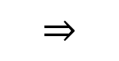



Example: Exercise 3
$$M$$
$$⇓$$
$$⇒$$
$$⇓$$
$$⇑$$
$…$ {"a": {"0": ["a", "_", "R"], "1": ["b", "_", "R"], "_": ["c", "_", "R"], "#": ["d", "_", "R"], "$": null, "&": null, "%": null, "@": null}, "b": {"0": ["y", "0", "R"], "1": ["b", "0", "R"], "_": ["c", "1", "R"], "#": ["d", $…$
$$\left\langle M\right\rangle$$
$$≈U$$

Slide 8
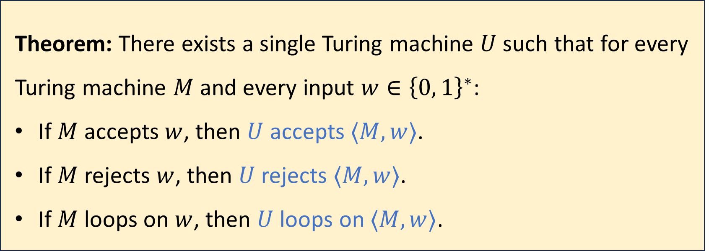
Universal Turing machines
Theorem: There exists a single Turing machine $U$ such that for every Turing machine $M$ and every input $w∈{\left\{0, 1\right\}}^{∗}$:
If $M$ accepts $w$, then $U$ accepts $⟨M,w⟩$.
If $M$ rejects $w$, then $U$ rejects $⟨M,w⟩$.
If $M$ loops on $w$, then $U$ loops on $⟨M,w⟩$.
To properly prove it, we need to clarify how $\left\langle M\right\rangle$ is defined

Slide 9
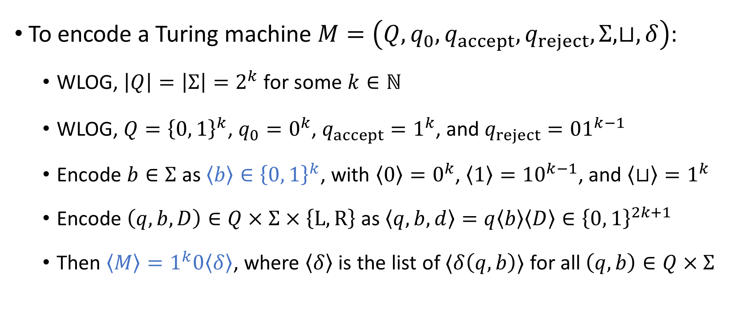
Encoding a Turing machine as a string
To encode a Turing machine $M=\left(Q,q_{0},q_{accept},q_{reject},Σ,⊔,δ\right)$:
WLOG, $\left|Q\right|=\left|Σ\right|=2^{k}$ for some $k∈ℕ$
WLOG, $Q={\left\{0, 1\right\}}^{k}$, $q_{0}=0^{k}$, $q_{accept}=1^{k}$, and $q_{reject}={01}^{k−1}$
Encode $b∈Σ$ as $\left\langle b\right\rangle ∈{\left\{0, 1\right\}}^{k}$, with $\left\langle 0\right\rangle =0^{k}$, $\left\langle 1\right\rangle ={10}^{k−1}$, and $\left\langle ⊔\right\rangle =1^{k}$
Encode $\left(q,b,D\right)∈Q×Σ×\left\{\text{L},\text{R}\right\}$ as $\left\langle q,b,d\right\rangle =q\left\langle b\right\rangle \left\langle D\right\rangle ∈{\left\{0, 1\right\}}^{2k+1}$
Then $\left\langle M\right\rangle =1^{k}0\left\langle δ\right\rangle$, where $\left\langle δ\right\rangle$ is the list of $⟨δ\left(q,b\right)⟩$ for all $\left(q,b\right)∈Q×Σ$

Slide 10
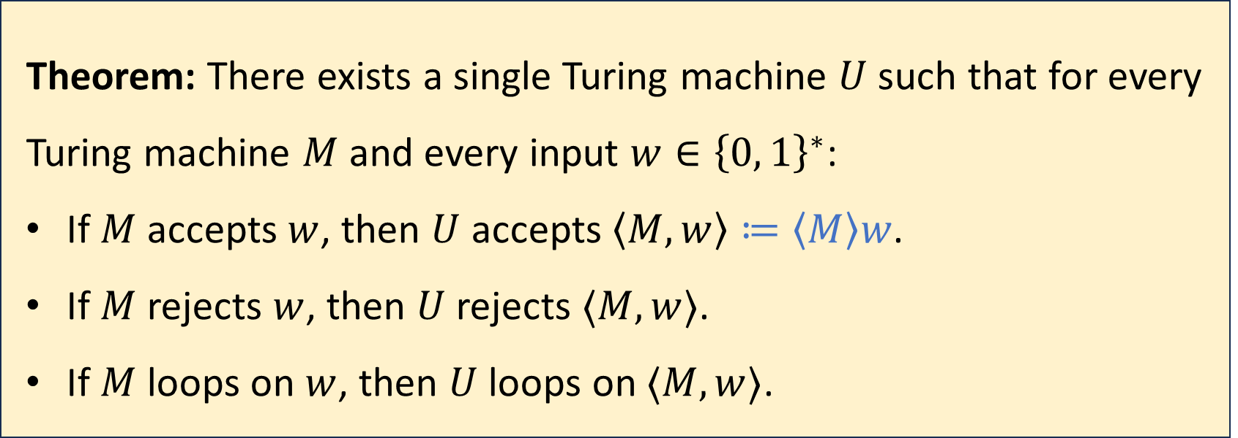
Universal Turing machines
Theorem: There exists a single Turing machine $U$ such that for every Turing machine $M$ and every input $w∈{\left\{0, 1\right\}}^{∗}$:
If $M$ accepts $w$, then $U$ accepts $\left\langle M,w\right\rangle ≔\left\langle M\right\rangle w$.
If $M$ rejects $w$, then $U$ rejects $⟨M,w⟩$.
If $M$ loops on $w$, then $U$ loops on $⟨M,w⟩$.
Proof sketch: Next two slides

Slide 11

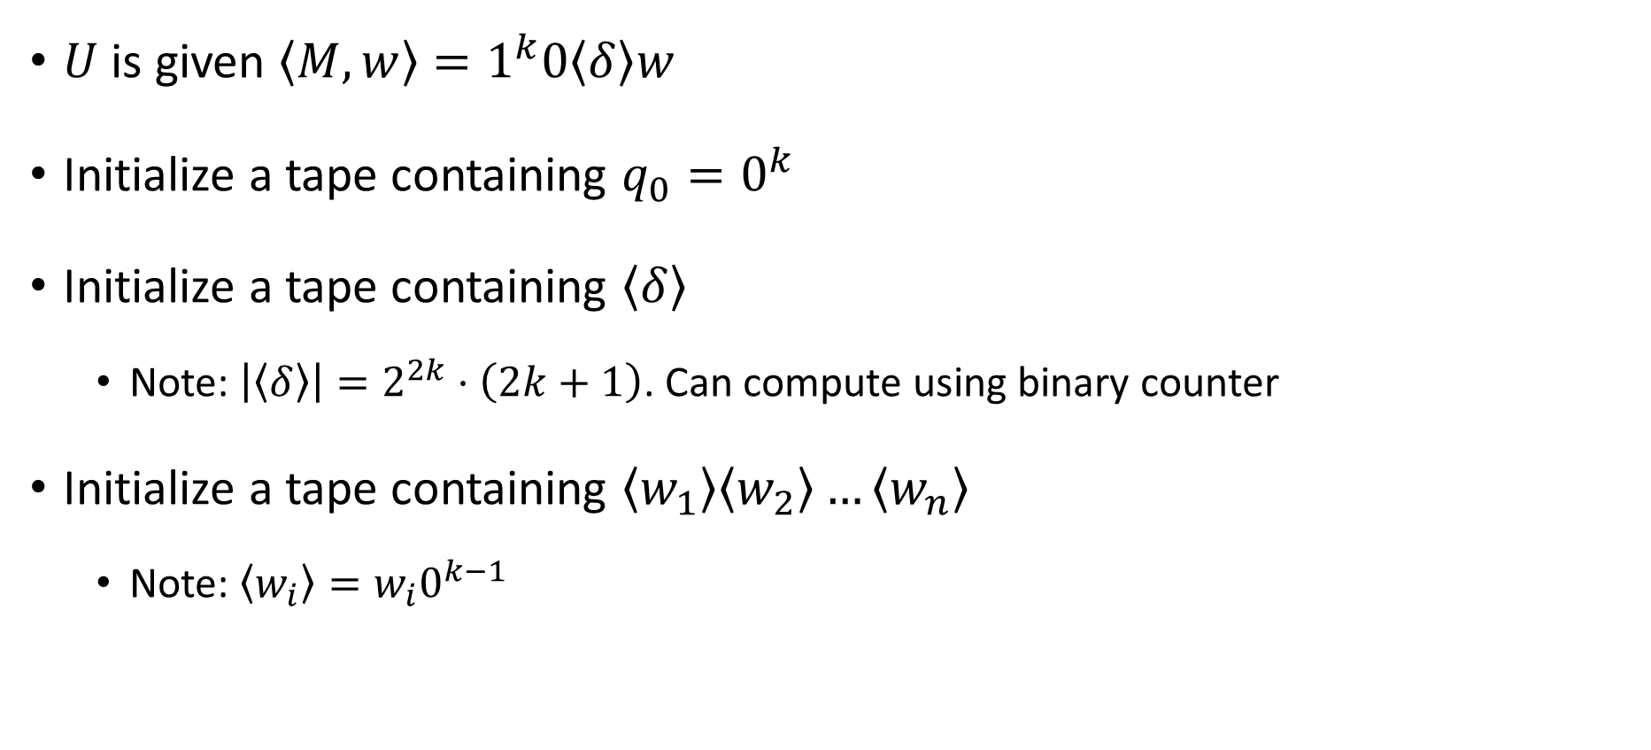



Initializing the simulation
$$1^{k}0\left\langle δ\right\rangle w$$
$$q_{0}$$
$U$ is given $\left\langle M,w\right\rangle =1^{k}0\left\langle δ\right\rangle w$
Initialize a tape containing $q_{0}=0^{k}$
Initialize a tape containing $\left\langle δ\right\rangle$
Note: $\left|\left\langle δ\right\rangle \right|=2^{2k}⋅\left(2k+1\right)$. Can compute using binary counter
Initialize a tape containing $\left\langle w_{1}\right\rangle \left\langle w_{2}\right\rangle …\left\langle w_{n}\right\rangle$
Note: $\left\langle w_{i}\right\rangle =w_{i}0^{k−1}$
$$\left\langle δ\right\rangle$$
$$\left\langle w_{1}\right\rangle \left\langle w_{2}\right\rangle …⟨w_{n}⟩$$

Slide 12

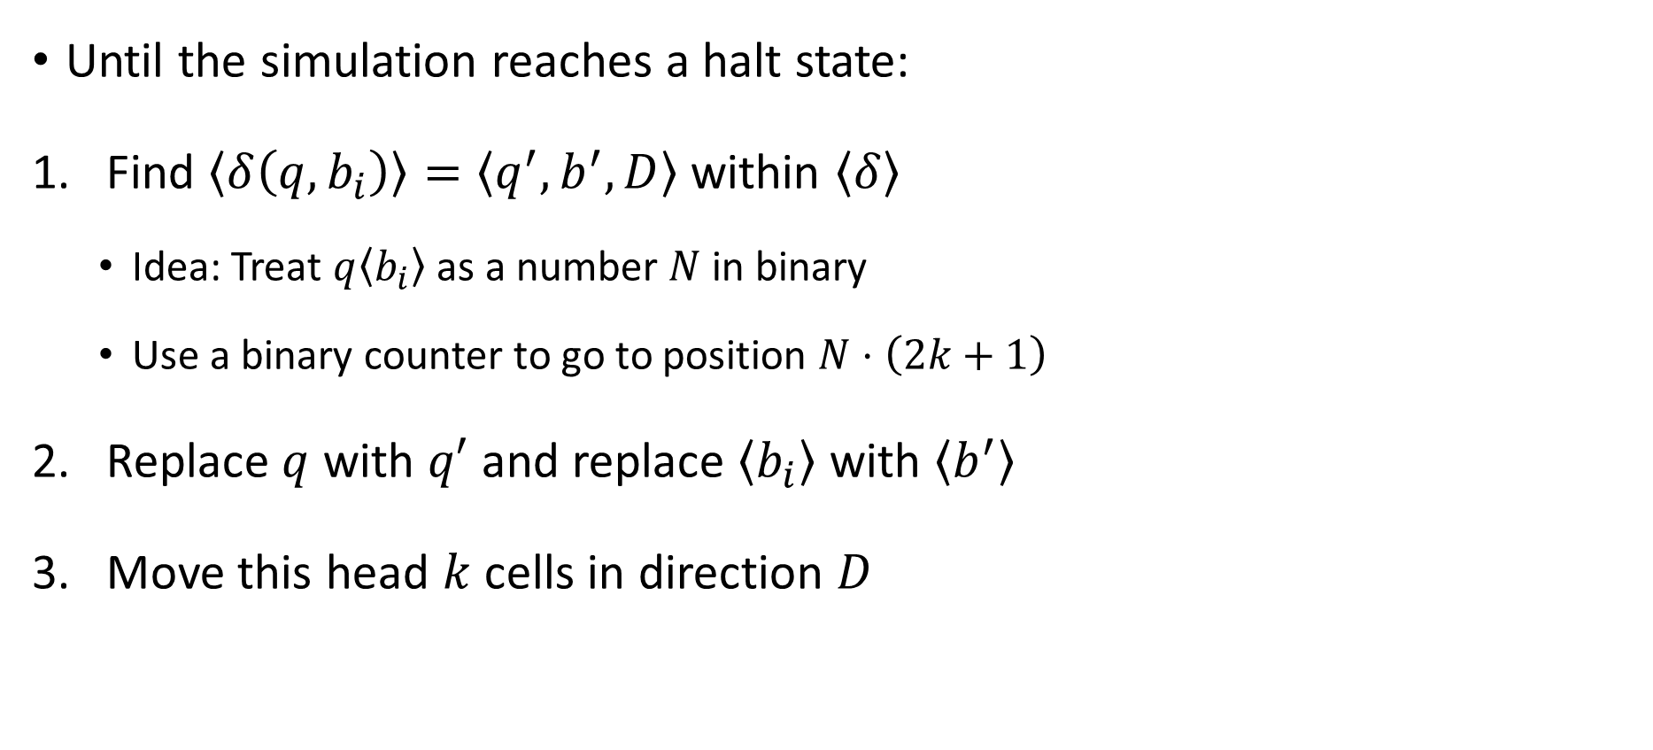



Advancing the simulation
$$1^{k}0\left\langle δ\right\rangle w$$
$$q$$
Until the simulation reaches a halt state:
Find $\left\langle δ\left(q,b_{i}\right)\right\rangle =\left\langle q^{′}, b^{′},D\right\rangle$ within $\left\langle δ\right\rangle$
Idea: Treat $q\left\langle b_{i}\right\rangle$ as a number $N$ in binary
Use a binary counter to go to position $N⋅\left(2k+1\right)$
Replace $q$ with $q′$ and replace $\left\langle b_{i}\right\rangle$ with $\left\langle b^{′}\right\rangle$
Move this head $k$ cells in direction $D$
$$\left\langle δ\right\rangle$$
$$…\left\langle b_{i−2}\right\rangle \left\langle b_{i−1}\right\rangle \left\langle b_{i}\right\rangle \left\langle b_{i+1}\right\rangle \left\langle b_{i+2}\right\rangle …$$

Slide 13

Interpretation of universal Turing machines
One piece of “hardware” that can run arbitrary “software”
It’s a general-purpose, programmable computer
This is why you don’t need a separate laptop for each task
If you want to build a computer from scratch in some post-apocalyptic future, then your job is to build a universal Turing machine

Slide 14
The Church-Turing Thesis
Let $Y⊆{\left\{0, 1\right\}}^{∗}$
Church-Turing Thesis:
There exists an “algorithm” / “procedure” for figuring out whether a given string is in $Y$ if and only if there exists a Turing machine that decides $Y$.
Intuitive notion
Mathematically precise notion

Slide 15
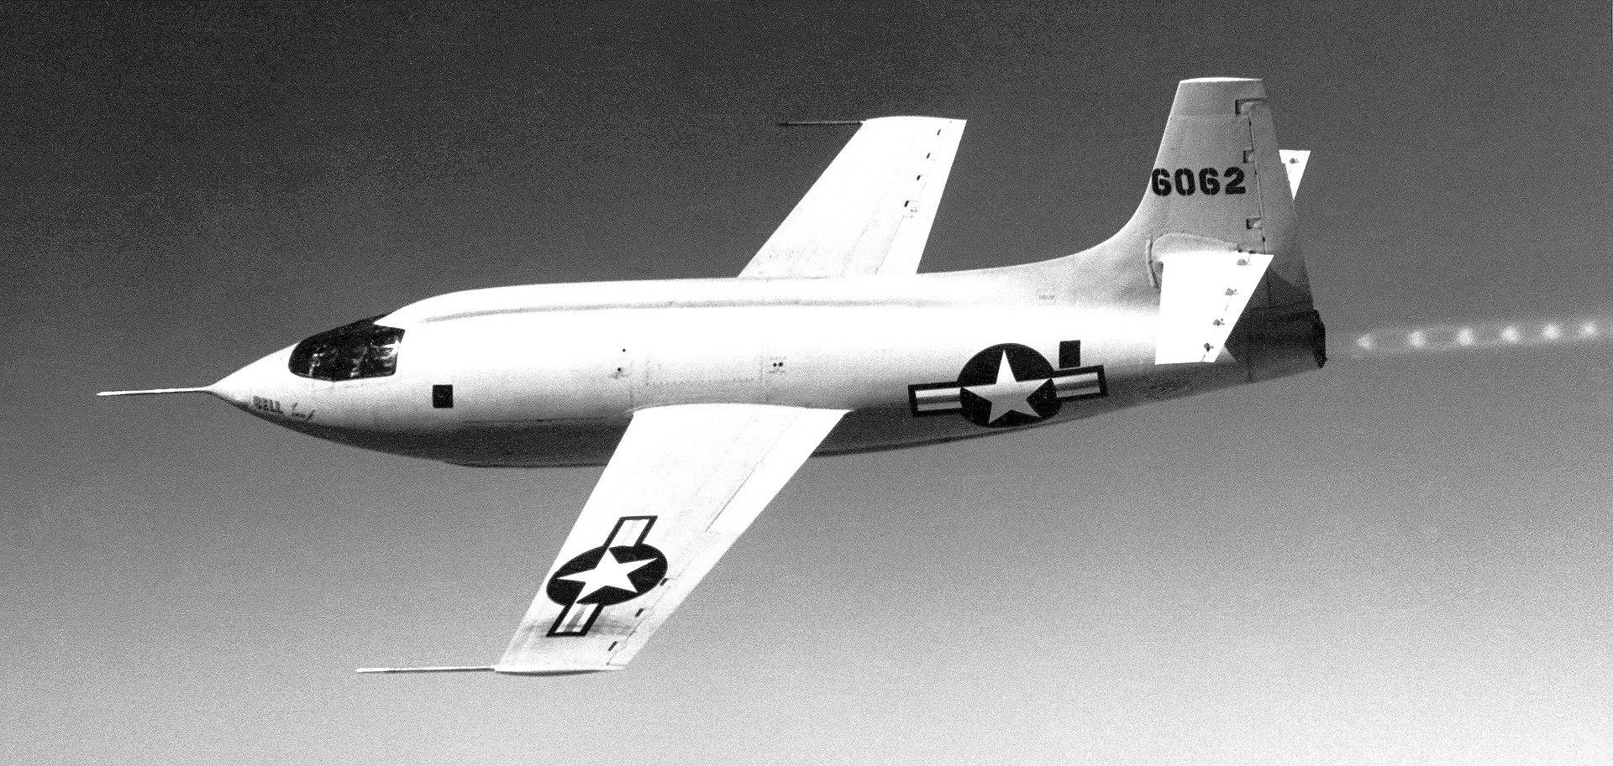
Humans vs. technology
OBJECTION: “The Turing machine model is based on paper-and-pencil computation. Maybe we can solve undecidable problems using advanced science and technology!”

Slide 16

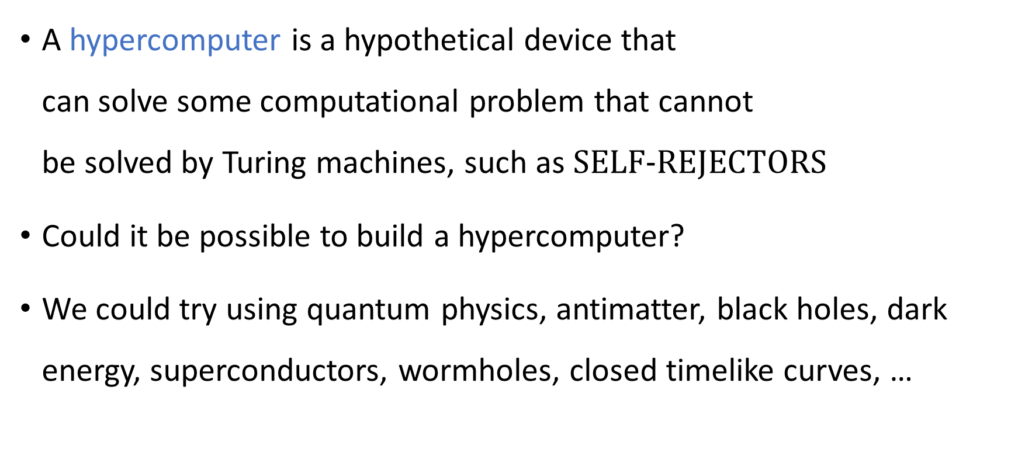
Hypercomputers
A hypercomputer is a hypothetical device that can solve some computational problem that cannot be solved by Turing machines, such as $\text{SELF}‑\text{REJECTORS}$
Could it be possible to build a hypercomputer?
We could try using quantum physics, antimatter, black holes, dark energy, superconductors, wormholes, closed timelike curves, …

Slide 17
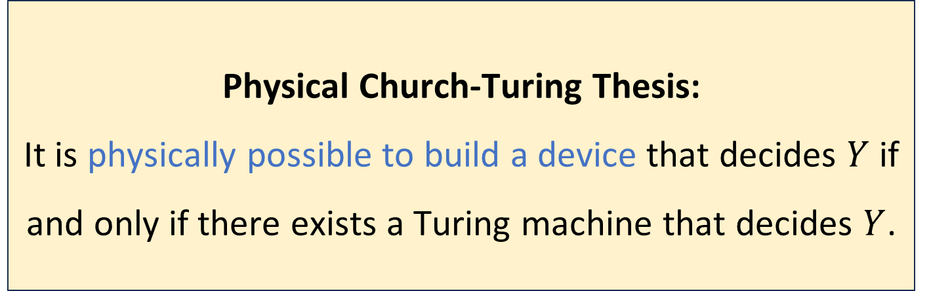
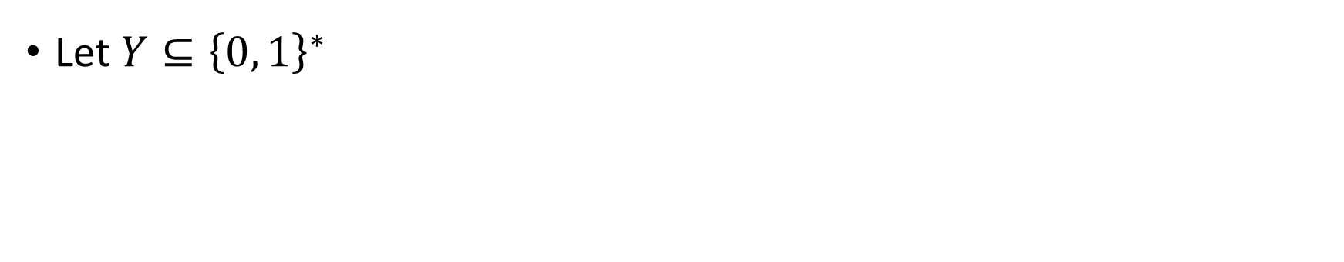
The Physical Church-Turing Thesis
Let $Y⊆{\left\{0, 1\right\}}^{∗}$
Physical Church-Turing Thesis:
It is physically possible to build a device that decides $Y$ if and only if there exists a Turing machine that decides $Y$.

Slide 18
The Physical Church-Turing Thesis
The standard Church-Turing thesis is a philosophical statement
The Physical Church-Turing thesis is a scientific law
Conceivably, it could be disproven by future discoveries… but that would be very surprising
Analogy: Second Law of Thermodynamics
Analogy: Cannot travel faster than the speed of light

Slide 19
Which problems can be solved through computation?

Slide 20
What are Turing machines capable of?

Slide 21
Which languages are decidable?

Slide 22
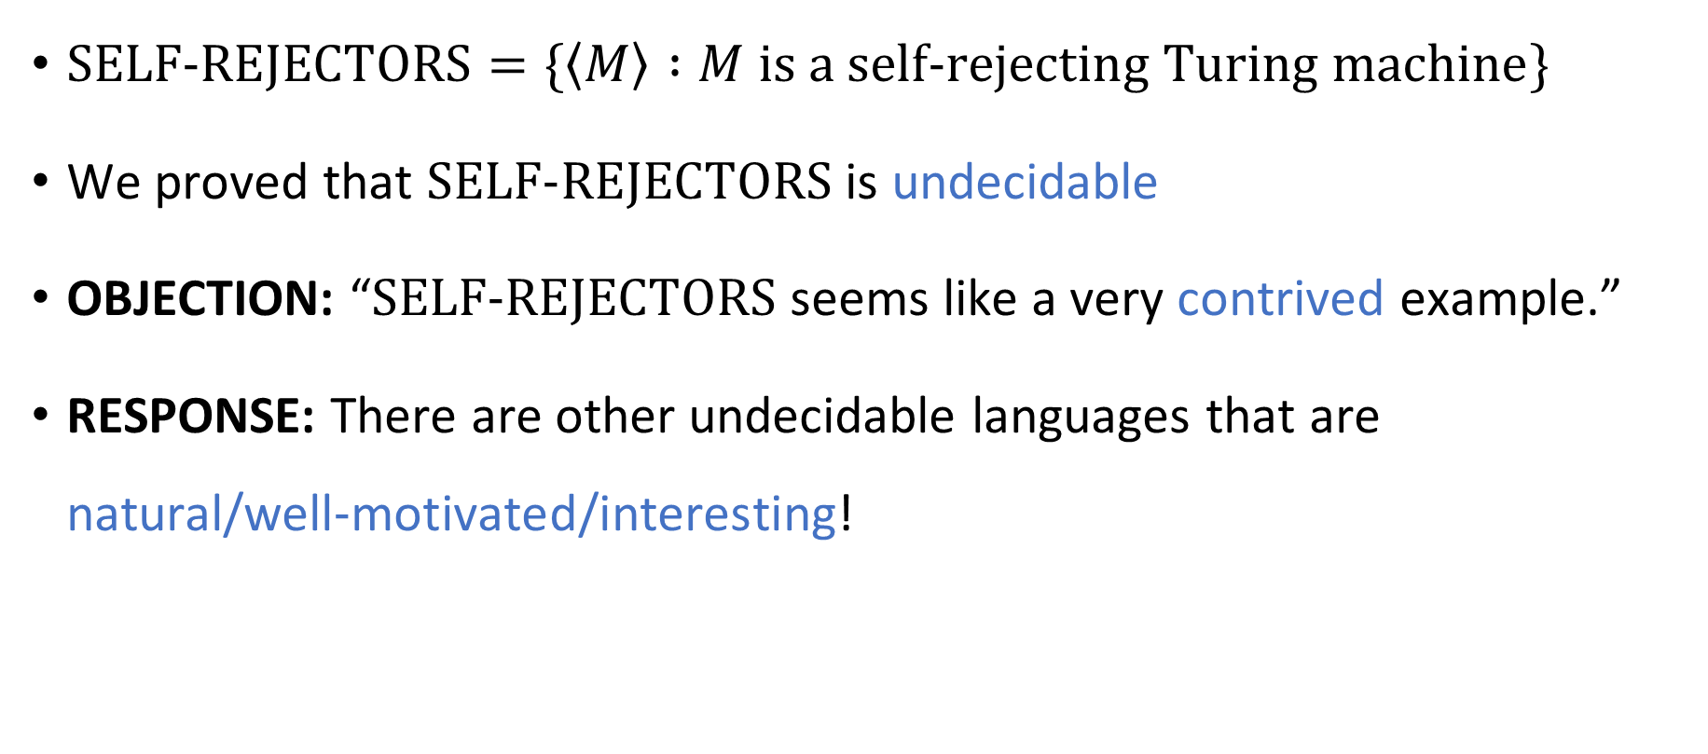
Contrived vs. natural
$\text{SELF}‑\text{REJECTORS}=\{\left\langle M\right\rangle :M \text{is} \text{a} \text{self}‑\text{rejecting} \text{Turing} \text{machine}\}$
We proved that $\text{SELF}‑\text{REJECTORS}$ is undecidable
OBJECTION: “$\text{SELF}‑\text{REJECTORS}$ seems like a very contrived example.”
RESPONSE: There are other undecidable languages that are natural/well‑motivated/interesting!

Slide 23
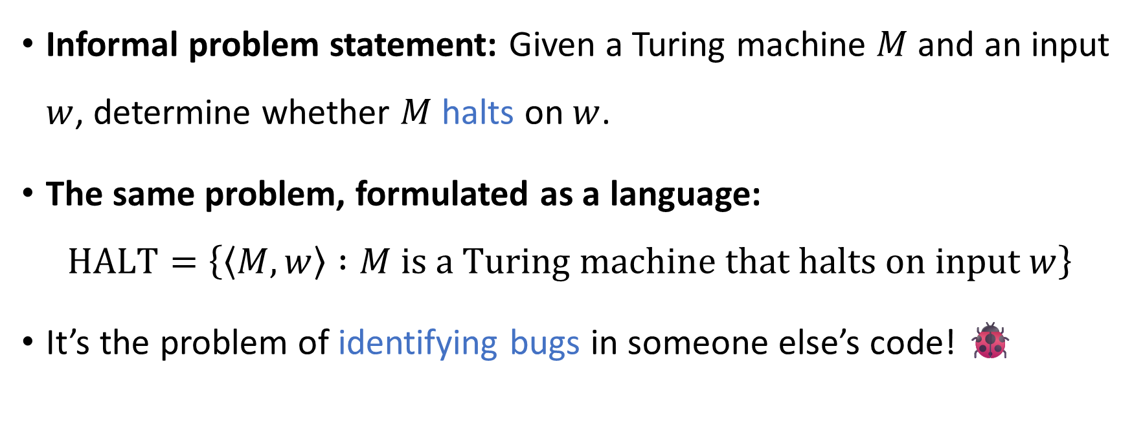
The halting problem
?
Informal problem statement: Given a Turing machine $M$ and an input $w$, determine whether $M$ halts on $w$.
The same problem, formulated as a language:
$$\text{HALT}=\left\{\left\langle M,w\right\rangle :M \text{is} \text{a} \text{Turing} \text{machine} \text{that} \text{halts} \text{on} \text{input} w\right\}$$
It’s the problem of identifying bugs in someone else’s code! 🐞

Slide 24
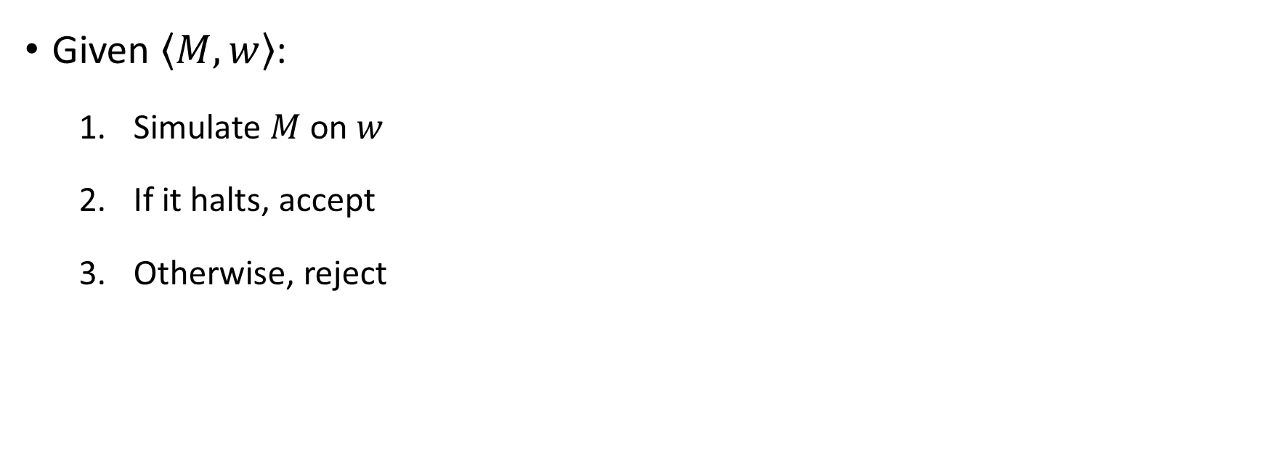


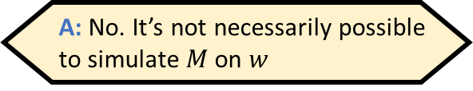
Attempting to decide $\text{HALT}$
?
Given $\left\langle M,w\right\rangle$:
Simulate $M$ on $w$
If it halts, accept
Otherwise, reject
Does the proposed algorithm work?
A: No. It’s not necessarily possible to simulate $M$ on $w$
B: No. There are inputs for which it should accept, but it doesn’t
C: No. There are inputs for which it should reject, but it doesn’t
D: Yes. $\text{HALT}$ is decidable
Respond at PollEv.com/whoza or text “whoza” to 22333

